Slide 1
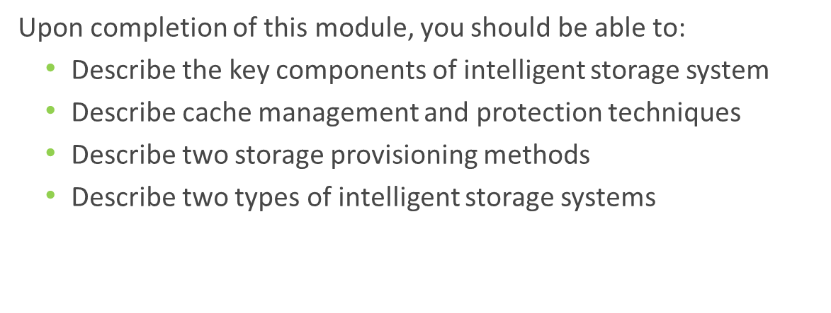
Intelligent Storage System

Slide 2
Key Components of an Intelligent Storage System
During this lesson the following topics are covered:
Intelligent storage system overview
Key components of an intelligent storage system
Cache management

Slide 3
What is an Intelligent Storage System (ISS) ?
Intelligent Storage System
It is a feature-rich RAID array that provides highly optimized I/O processing capabilities.
Provides large amount of cache and multiple I/O paths that enhances the performance
Has an operating environment that provides
Intelligent cache management
Array resource management
Connectivity to heterogeneous hosts
Supports flash drive, virtual provisioning, and automated storage tiering

Slide 4
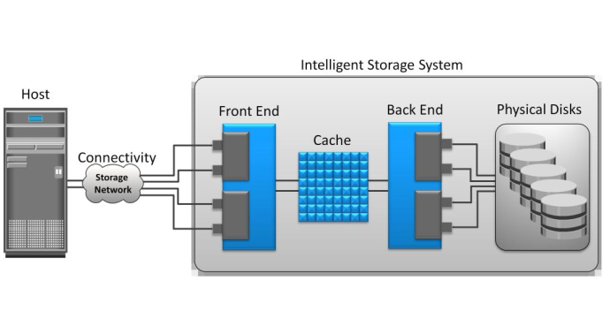
Key Components of an ISS

Slide 5
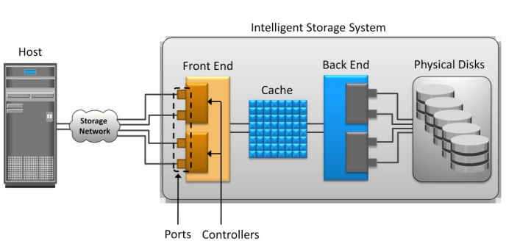
Key Components of ISS: Front End

Slide 6
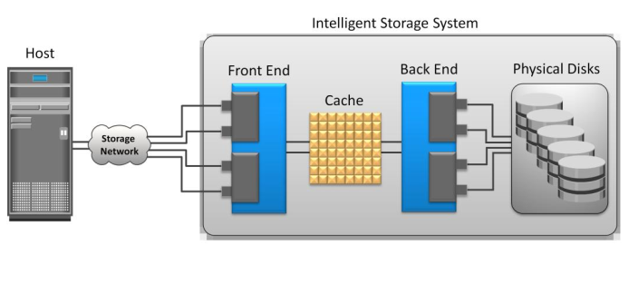
Key Components of ISS: Cache

Slide 7
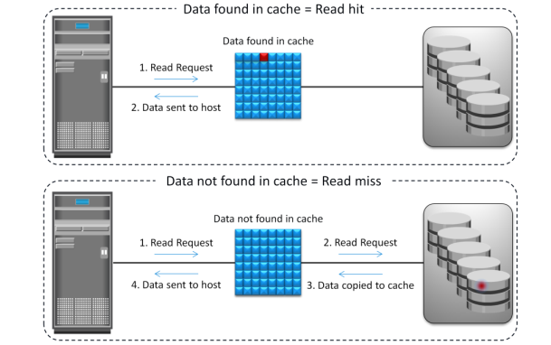
Read Operation with Cache

Slide 8
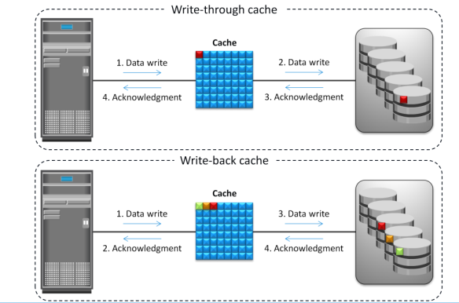
Write Operation with Cache

Slide 9
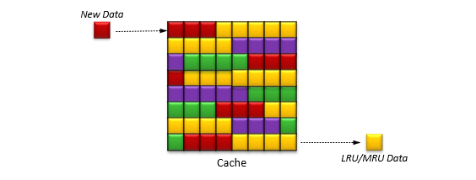
Least recently used (LRU)
Discards data that have not been accessed for a long time
Most recently used (MRU)
Discards data that have been most recently accessed

Slide 10
Cache Data Protection
Protects data in the cache against power or cache failures:
Cache mirroring
Provides protection to data against cache failure
Each write to the cache is held in two different memory locations on two independent memory cards
Cache vaulting
Provides protection to data against power failure
In the event of power failure, uncommitted data is dumped to a dedicated set of drives called vault drives

Slide 11
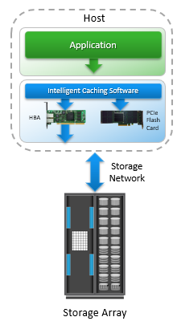
Server Flash-caching Technology
Uses intelligent caching software and PCIe flash card on host
Dramatically improves application performance
Provides performance acceleration for read-intensive workloads
Avoids network latencies associated with I/O access to the storage array
Intelligently determines data that would benefit by sitting in server on PCIe flash
Uses minimal CPU and memory resources
Flash management is offloaded onto PCIe card

Slide 12
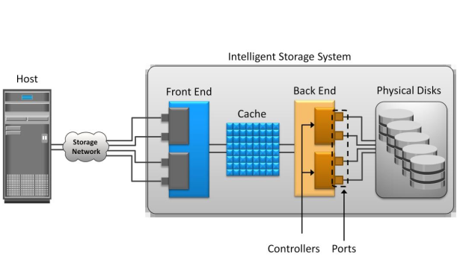
Key Components of ISS: Back End

Slide 13
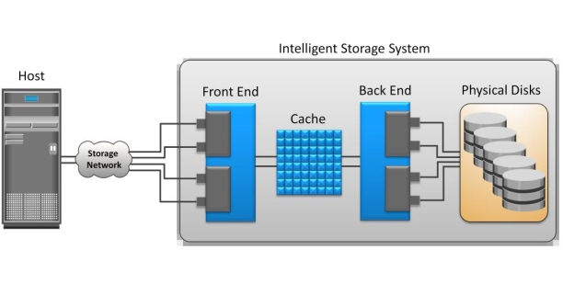
Key Components of ISS: Physical Disks

Slide 14
Storage provisioning and ISS implementation
During this lesson the following topics are covered:
Traditional storage provisioning
Virtual storage provisioning
ISS implementation

Slide 15
Storage Provisioning
It is the process of assigning storage resources to hosts based on capacity, availability, and performance requirements of applications running on the hosts.
Can be performed in two ways:
Traditional storage provisioning
Virtual storage provisioning

Slide 16
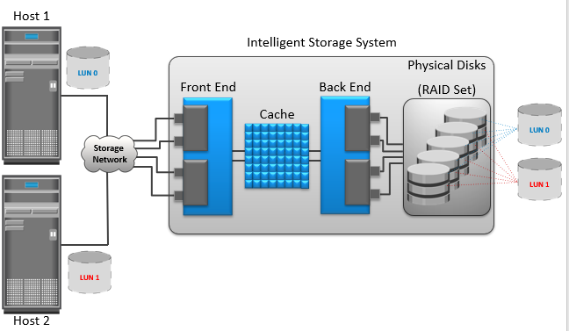
Traditional Storage Provisioning

